Slide 1
Website for a iconic scene
-Shreyash Bhagvat
A1
Roll no. - 52

Slide 2
A scene recreated
I made this website using images from a video(https://www.youtube.com/watch?v=pOP0eXvgplU&t=4s)
So if you scroll down through the website it feels like you are watching that very screen

Slide 3
Navigation section
For navigation section i used a header tag and then inserted a nav tag
In the nav tag i connected the scene and about section with the help of href tag(by using classes)
For the song i used a audio tag

Slide 4
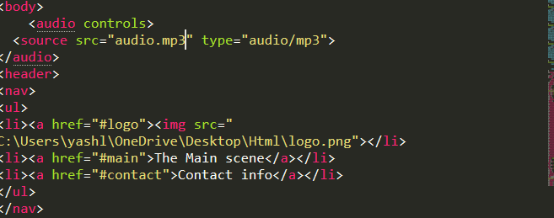

Slide 5
The main content
The main content was made using classes
I divided the images and for each image i made a different class like this in the css section then i added it to main section by using section tag for each class(image)

Slide 6
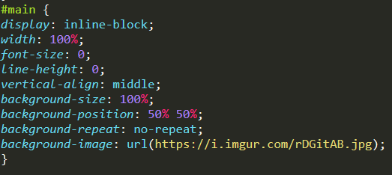


Slide 7
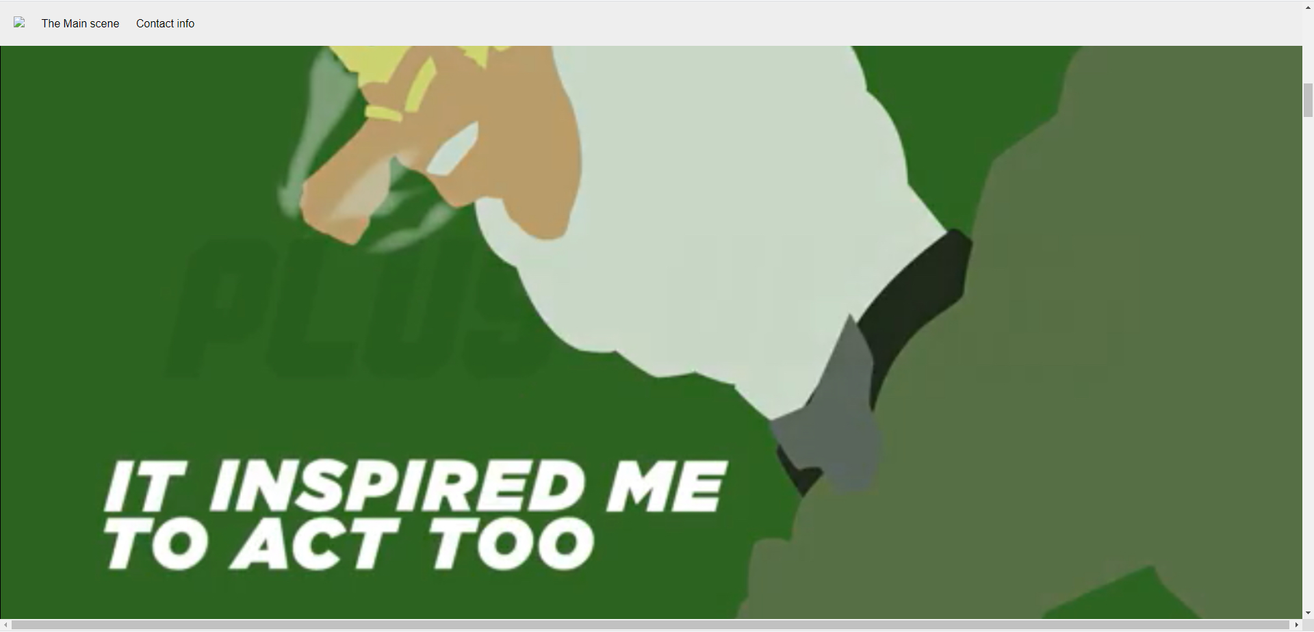

Slide 8
note
The images were uploaded on imgur and added using background-image tag in the css section

Slide 9
The about section page
For the about section’s background image i had to make some tweaks in my default image to make it look transparent (using a different class ofcourse)
For the links i used a href tag and inserted the links

Slide 10
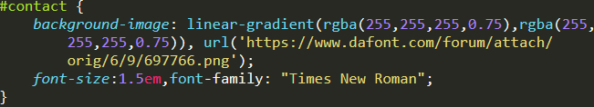
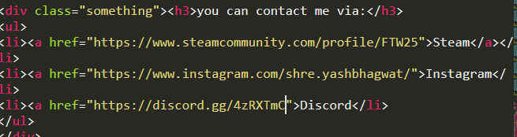

Slide 11
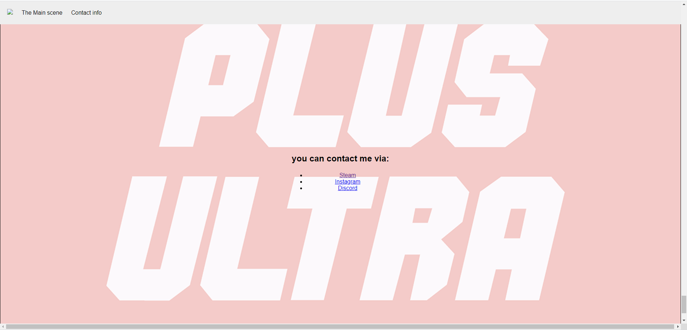

Slide 12
Credits section
For credits section i used a footer tag to make a allocation of space in the page and then used a href tag to add the link of the video

Slide 13


Slide 14
Thank you
Created by-
Shreyash Bhagvat
Roll no.- 52
Section- A1

